Slide 1
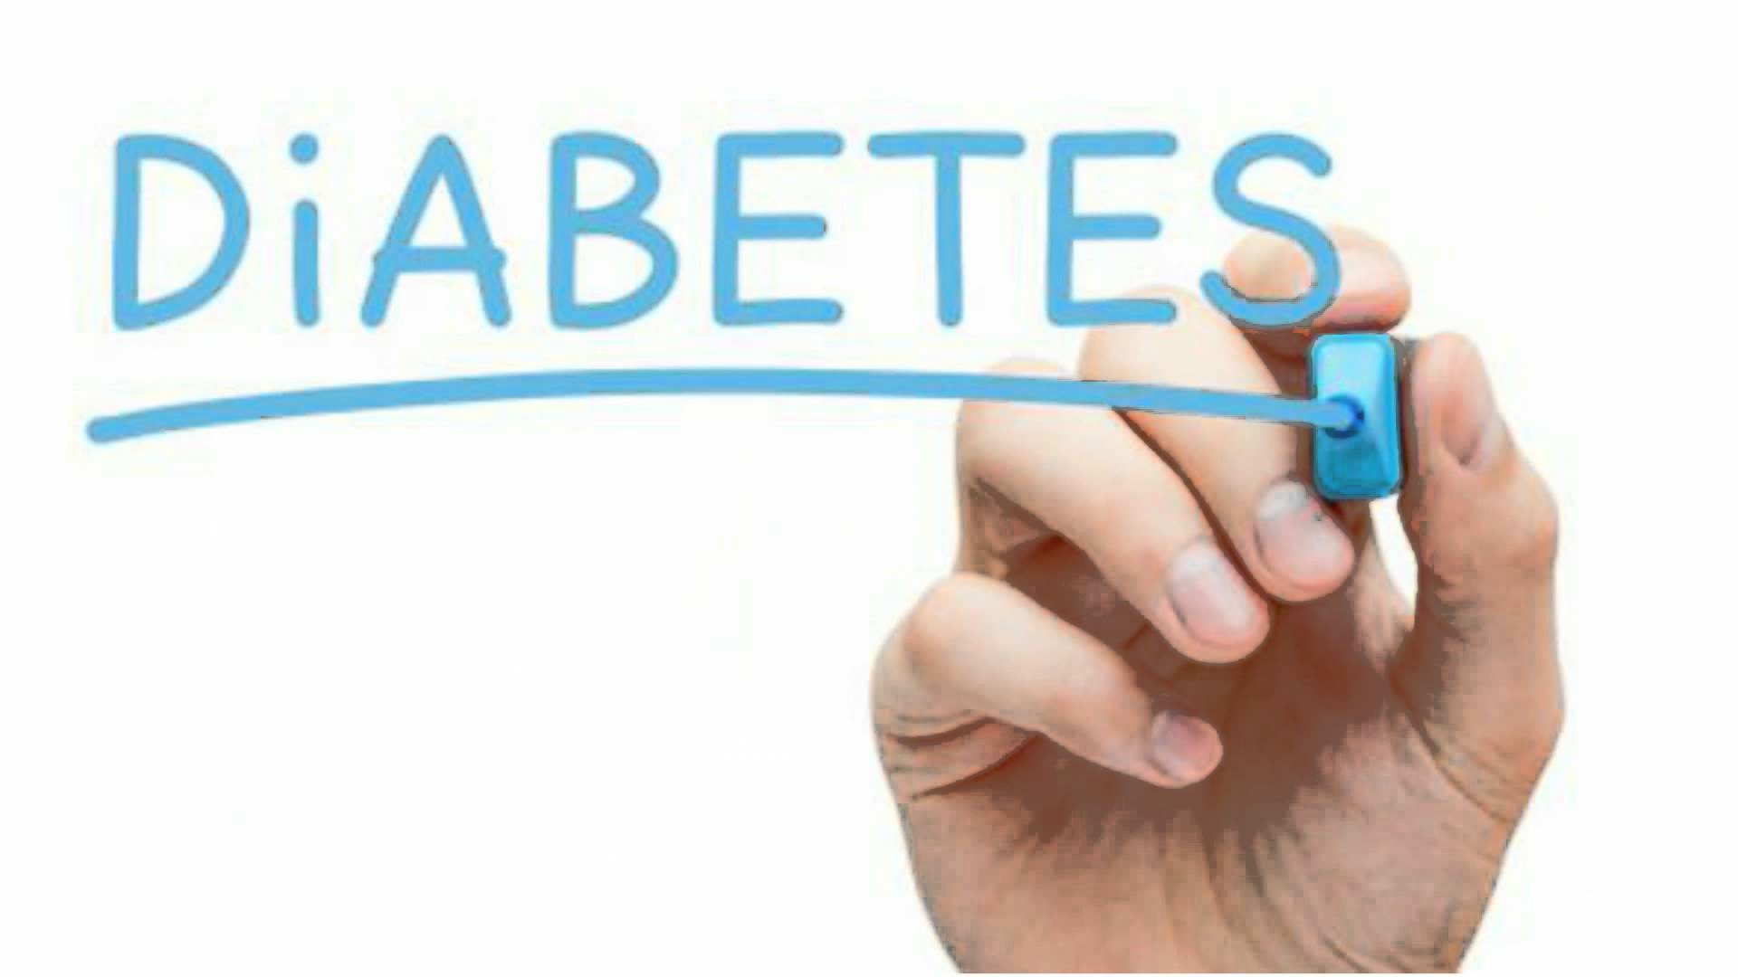

Slide 2
DIABETES
What is Diabetes?
Diabetes is a chronic disease that occurs when the pancreas is no longer able to make insulin, or when the body cannot make good use of the insulin it produces.
Objective:
The objective of this project is to classify whether someone has diabetes or not.
Dataset consists of several Medical Variables(Independent) and one Outcome Variable(Dependent)
The independent variables in this data set are :-'Glucose', 'Blood Pressure', 'Skin Thickness', 'Insulin’, ’ BMI ', 'Diabetes Pedigree Function', 'Age'
The outcome variable value is either 1 or 0 indicating whether a person has diabetes(1) or not(0).

Slide 3
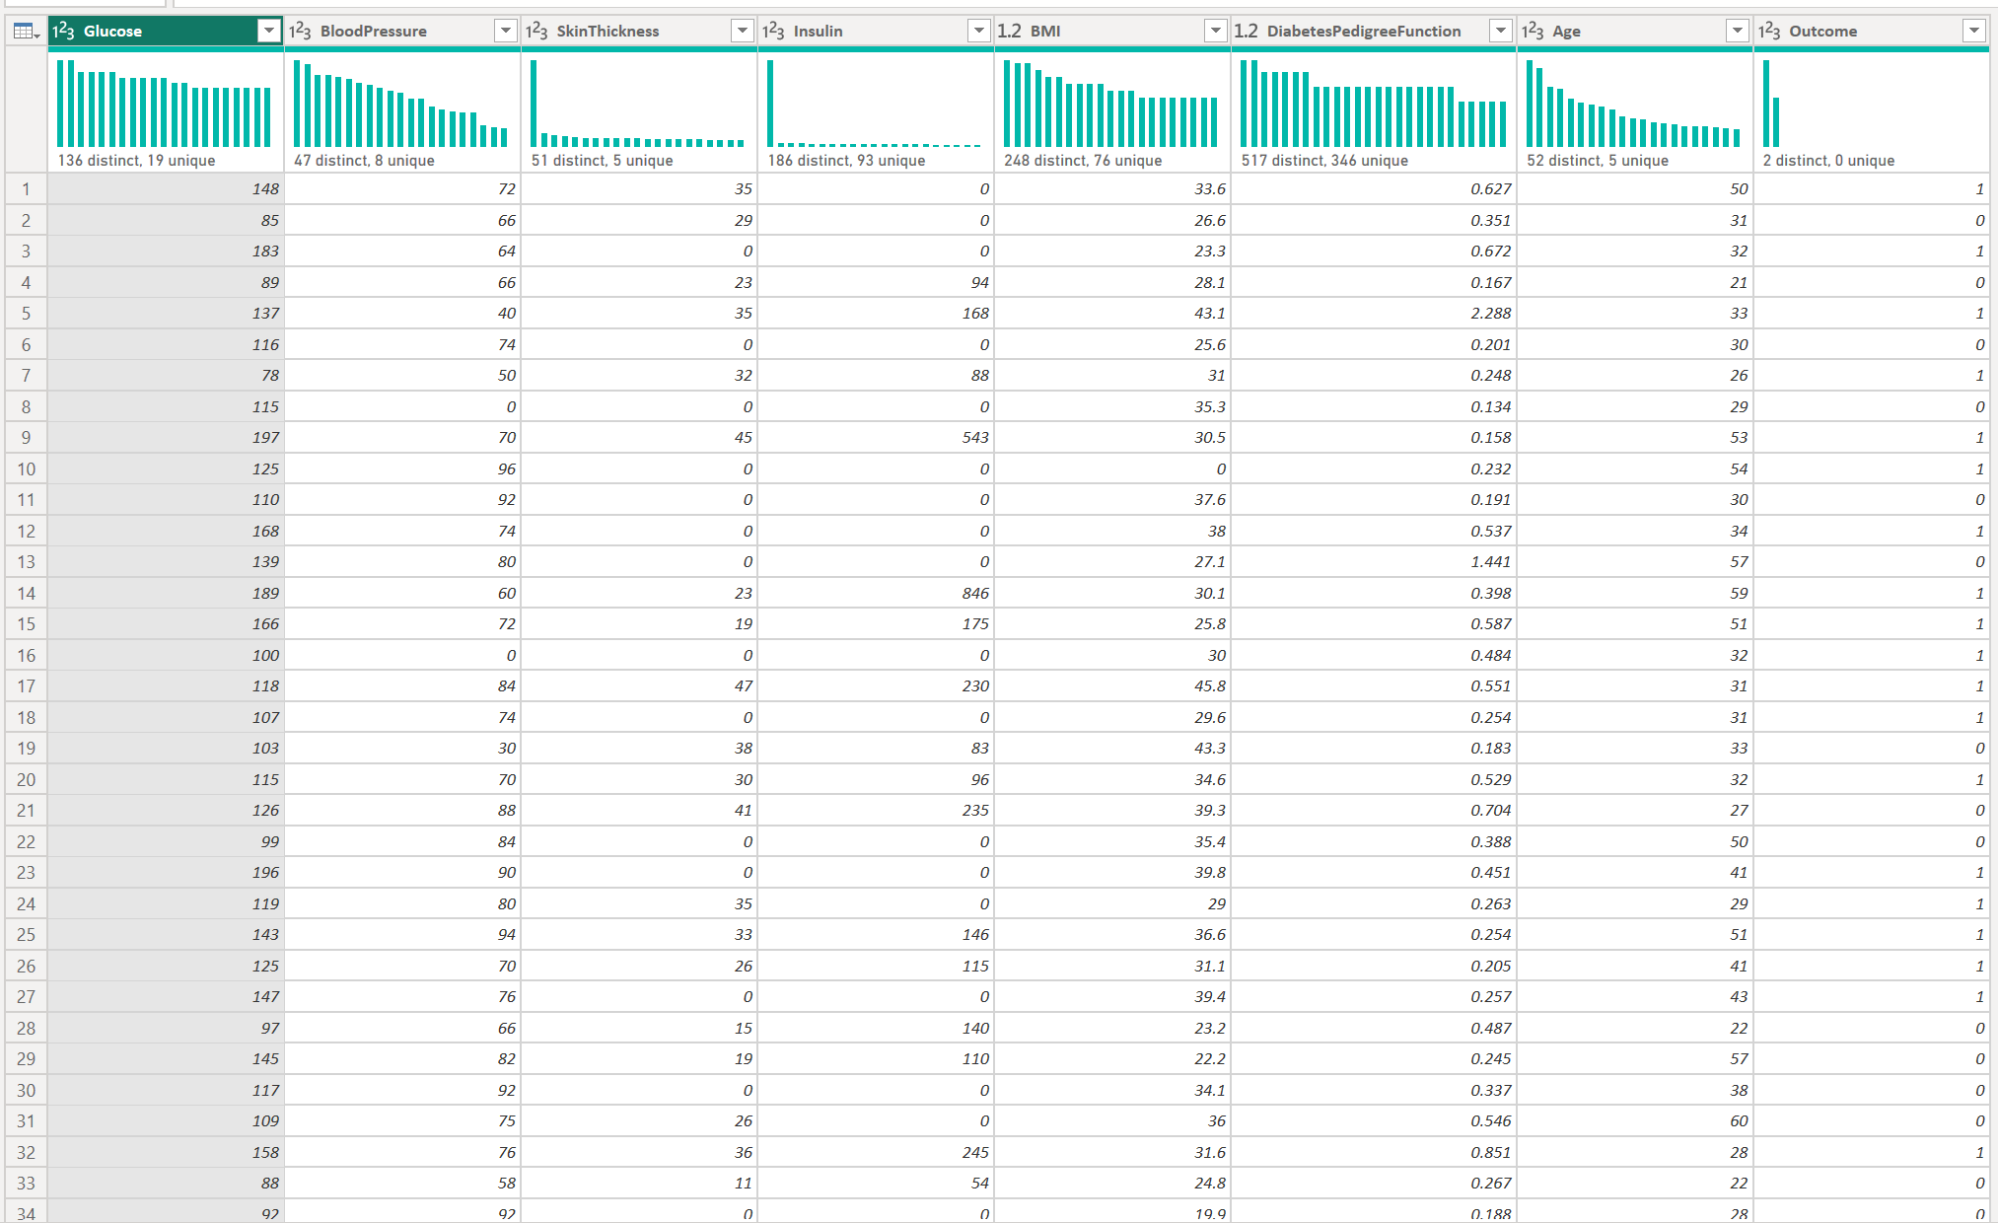
About Dataset
Glucose :- Plasma Glucose concentration of 2 hours in an oral glucose tolerance test
Blood Pressure :- Diastolic Blood Pressure (mm hg)
Skin Thickness :- Triceps skin fold thickness(mm)
Insulin :- 2 hour serum insulin(mu U/ml)
BMI :- Body Mass Index ((weight in kg/height in m)^2)
Age :- Age(years)
Diabetes Pedigree Function :-scores likelihood of diabetes based on family history)
Outcome :- 0(doesn't have diabetes) or 1 (has diabetes)

Slide 4
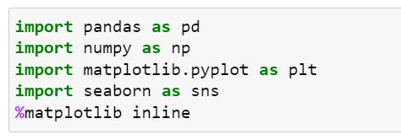
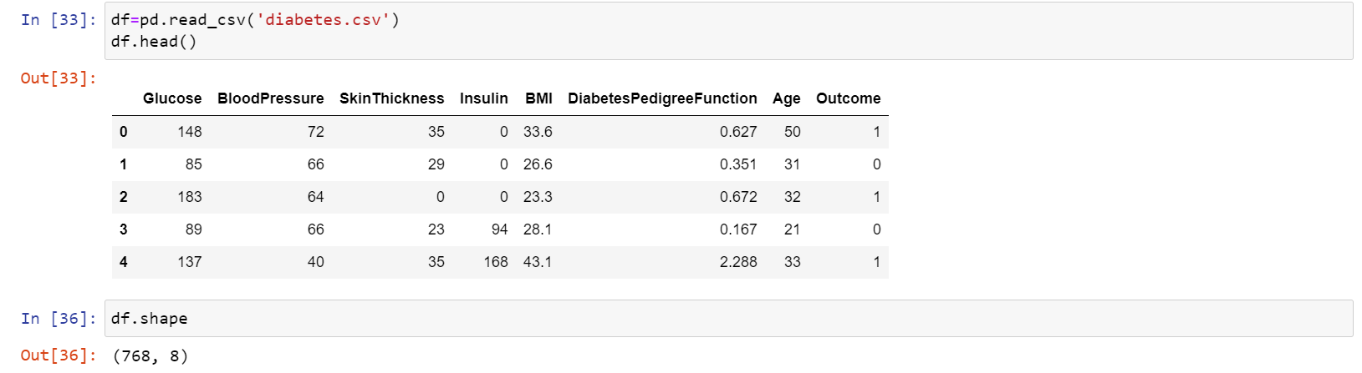
1) Importing Required Libraries:
2) Loading the Dataset:

Slide 5
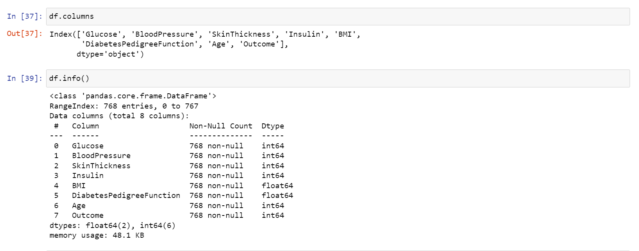
3. Exploratory Data Analysis
a. Understanding the dataset

Slide 6
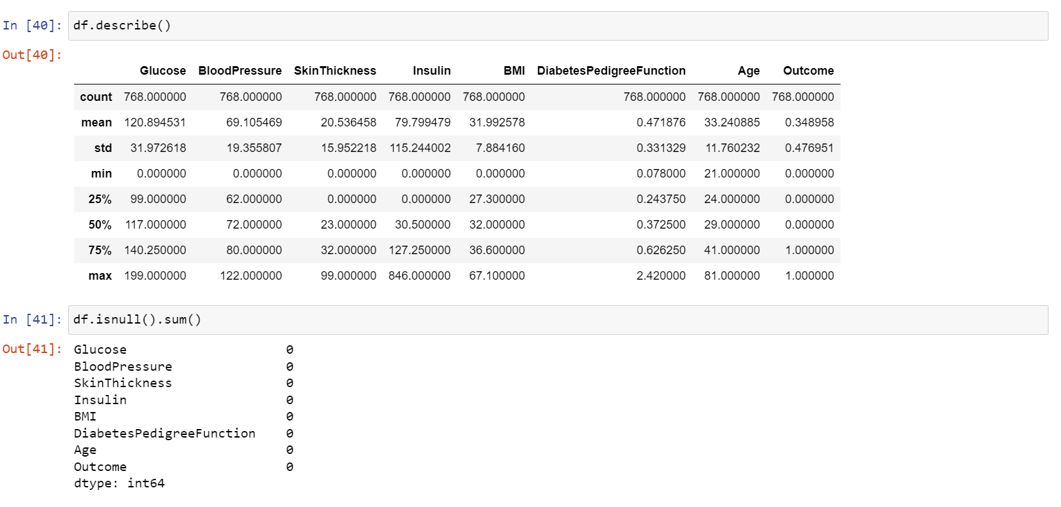
CONCLUSION :- We observe that min value of some columns is 0 which cannot be possible medically. Hence in the data cleaning process we'll have to replace them with median/mean value depending on the distribution.

Slide 7
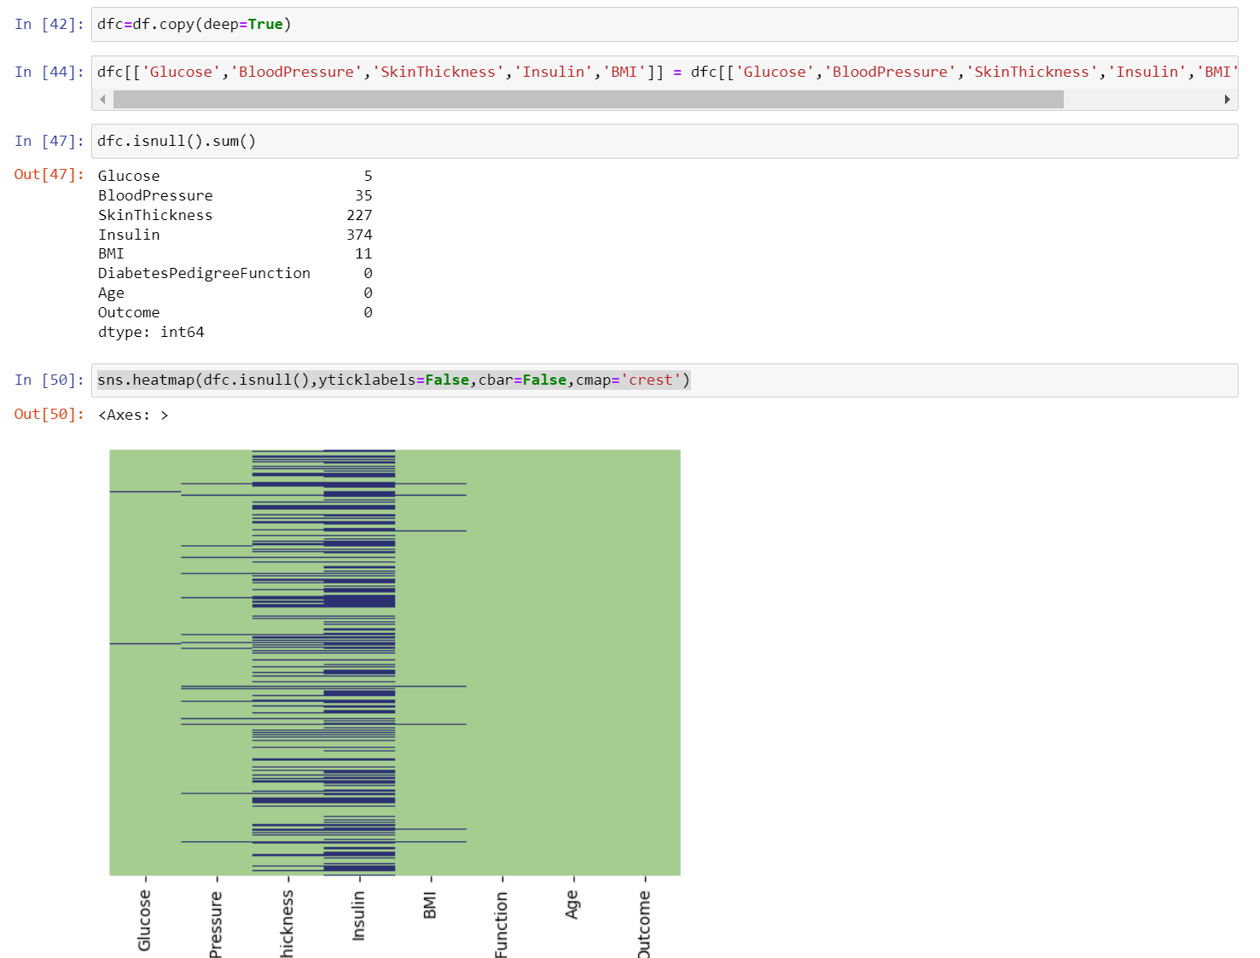

Slide 8
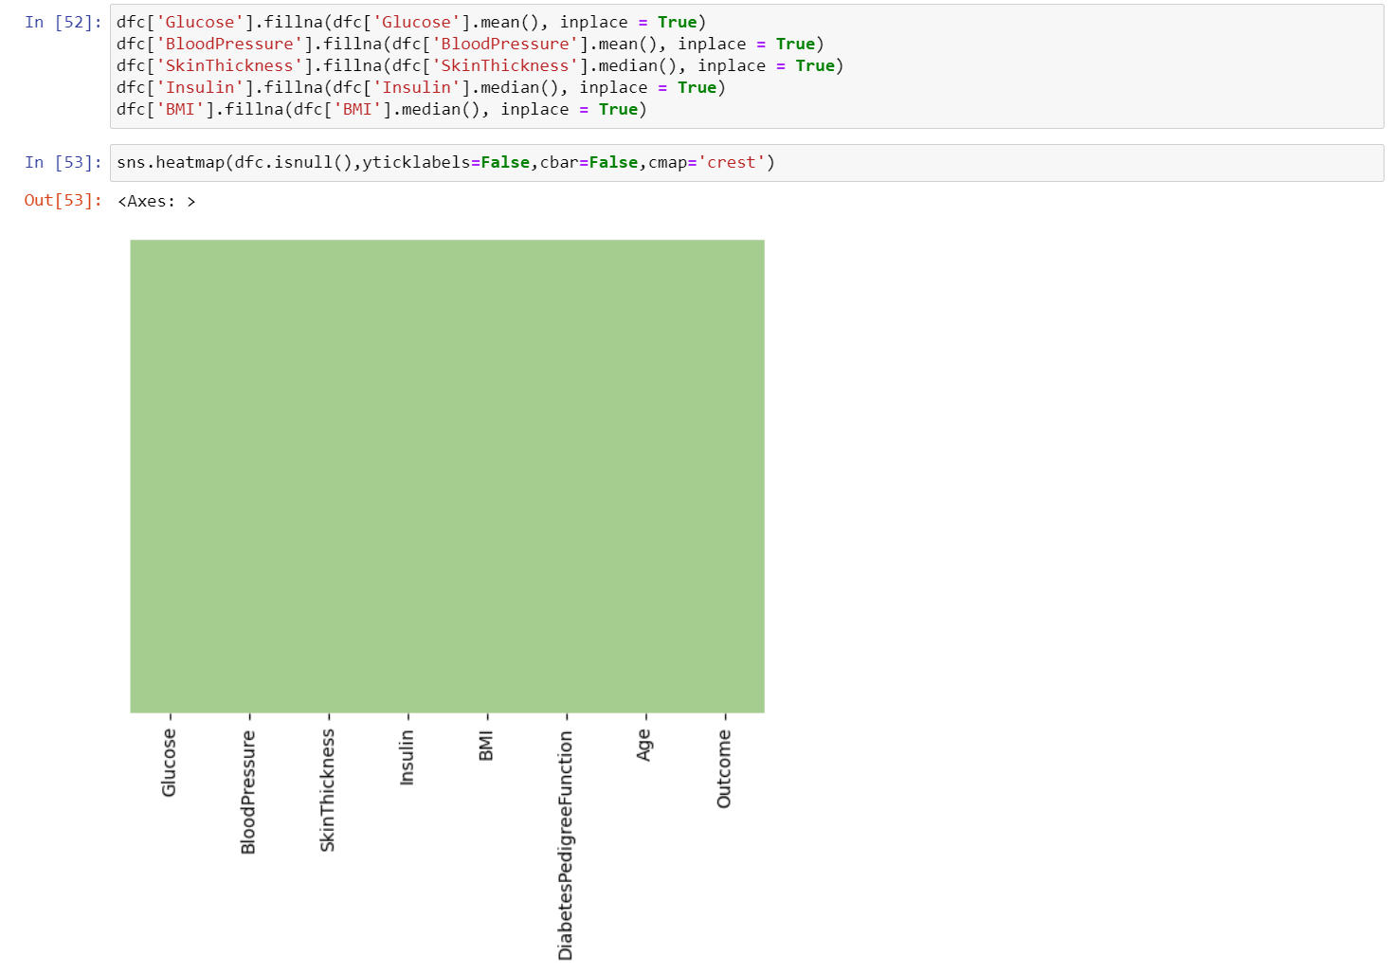

Slide 9
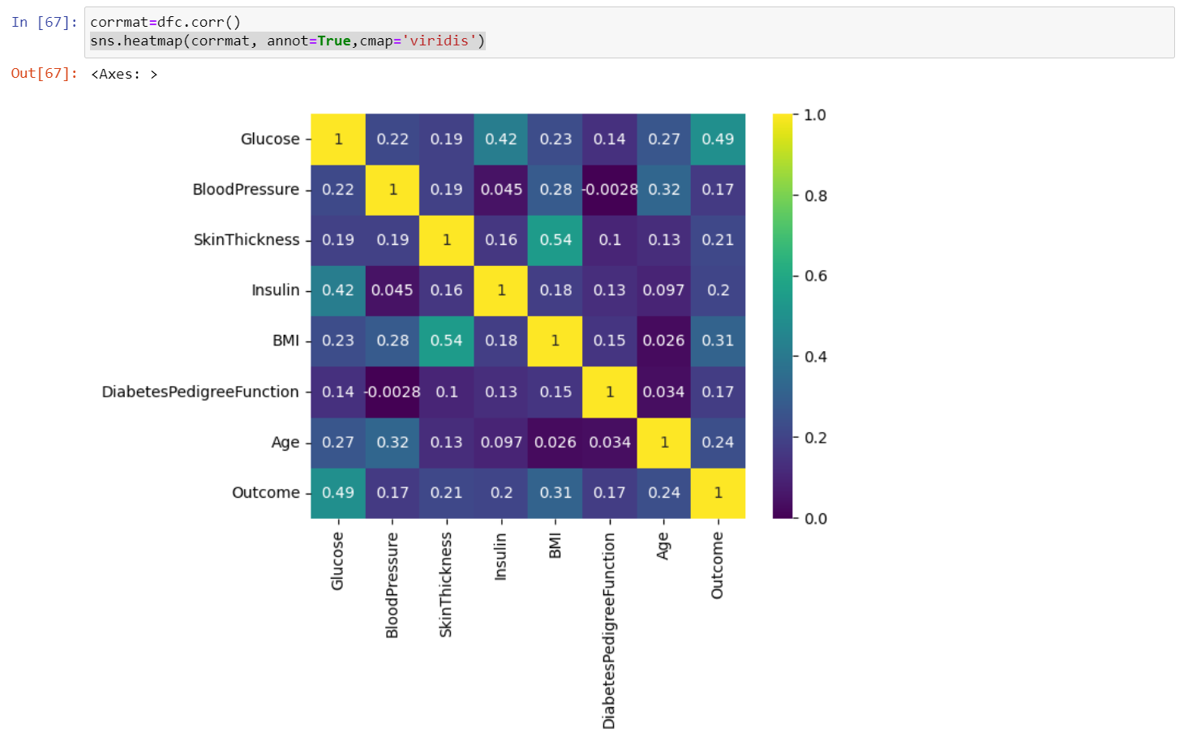
4. Feature Selection
Pearson's Correlation Coefficient : Helps you find out the relationship between two quantities. It gives you the measure of the strength of association between two variables. The value of Pearson's Correlation Coefficient can be between -1 to +1. 1 means that they are highly correlated and 0 means no correlation.
CONCLUSION :- Observe the last row 'Outcome' and note its correlation scores with different features. We can observe that Glucose, BMI and Age are the most correlated with Outcome. BloodPressure, Insulin, DiabetesPedigreeFunction are the least correlated, hence they don't contribute much to the model so we can drop them.

Slide 10
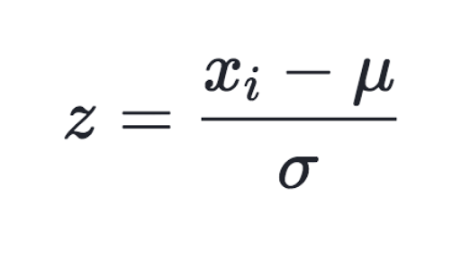
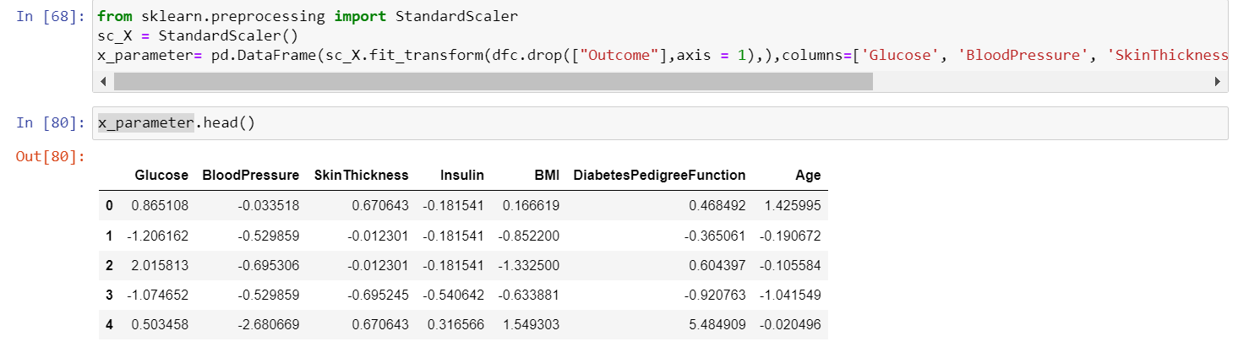
4. Scaling Data
We can imagine how the feature with greater range with overshadow or dimenish the smaller feature completely and this will impact the performance of all distance based model as it will give higher weightage to variables which have higher magnitude

Slide 11
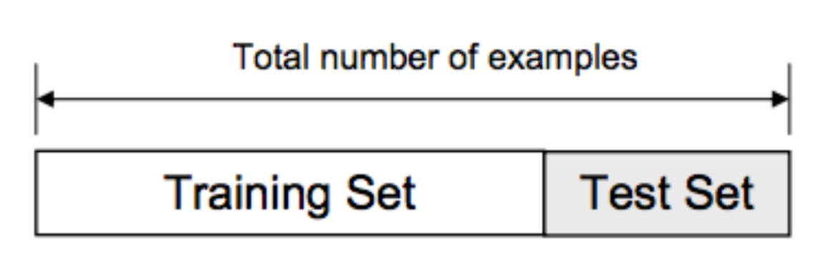
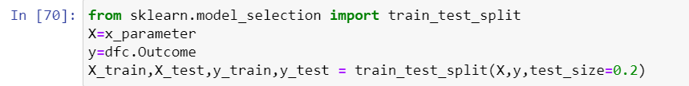
4. Train Test Split Data
Train Test Split : To have unknown datapoints to test the data rather than testing with the same points with which the model was trained. This helps capture the model performance much better.

Slide 12
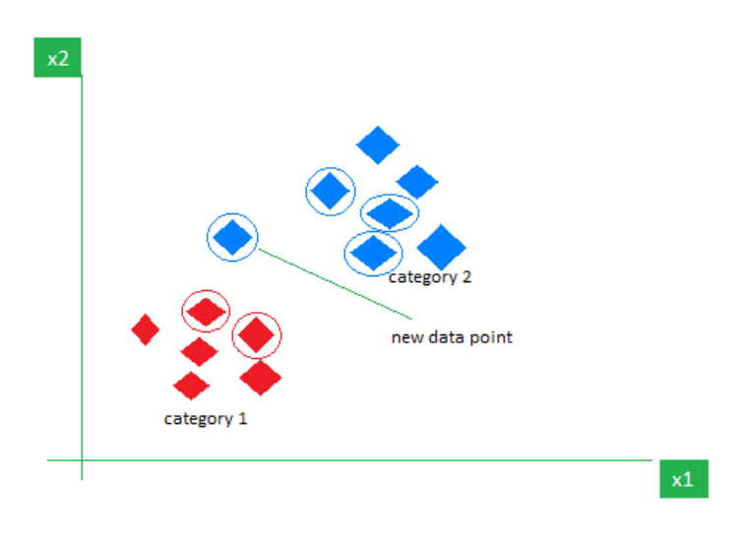
What is the K-Nearest Neighbors Algorithm?
K-Nearest Neighbours is one of the most basic yet essential classification algorithms in Machine Learning. It belongs to the supervised learning domain and finds intense application in pattern recognition, data mining, and intrusion detection.
It is widely disposable in real-life scenarios since it is non-parametric, meaning, it does not make any underlying assumptions about the distribution of data (as opposed to other algorithms such as GMM, which assume a Gaussian distribution of the given data). We are given some prior data (also called training data), which classifies coordinates into groups identified by an attribute.
As an example, consider the following table of data points containing two features:

Slide 13

Why do we need a KNN algorithm?
The K-NN algorithm works by finding the K nearest neighbors to a given data point based on a distance metric, such as Euclidean distance. The class or value of the data point is then determined by the majority vote or average of the K neighbors. This approach allows the algorithm to adapt to different patterns and make predictions based on the local structure of the data.
Euclidean Distance
This is nothing but the cartesian distance between the two points which are in the plane/hyperplane. Euclidean distance can also be visualized as the length of the straight line that joins the two points which are into consideration. This metric helps us calculate the net displacement done between the two states of an object.

Slide 14
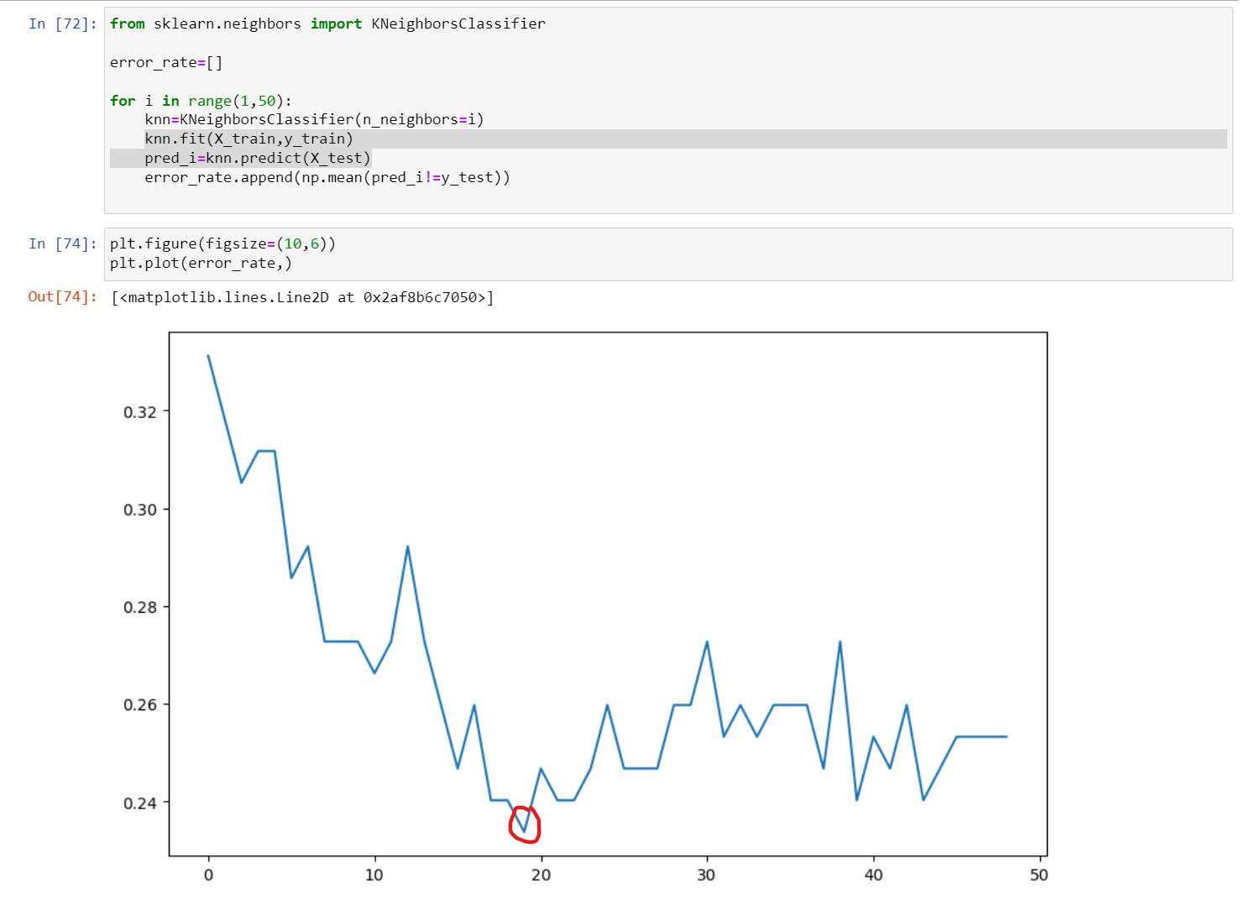

Slide 15
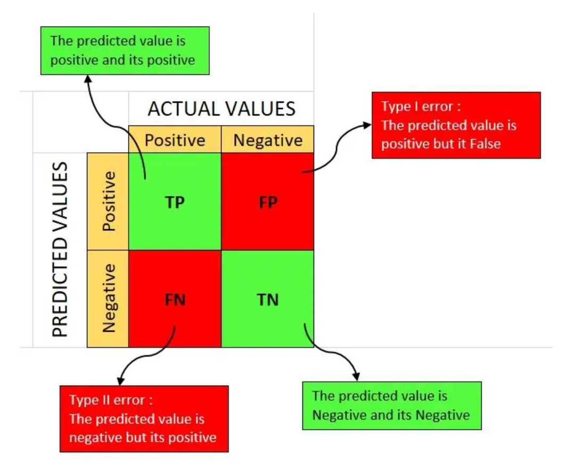
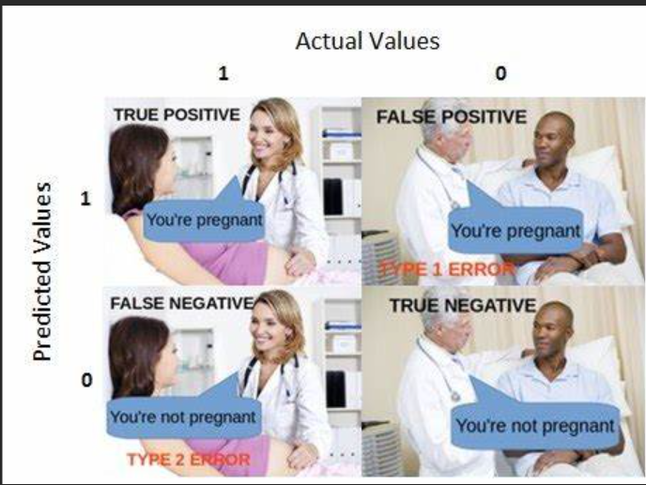
Confusion Matrix
A confusion matrix is a matrix that summarizes the performance of a machine learning model on a set of test data. It is often used to measure the performance of classification models, which aim to predict a categorical label for each input instance. The matrix displays the number of true positives (TP), true negatives (TN), false positives (FP), and false negatives (FN) produced by the model on the test data.

Slide 16




Accuracy: Accuracy is used to measure the performance of the model. It is the ratio of Total correct instances to the total instances.
Recall: Recall measures the effectiveness of a classification model in identifying all relevant instances from a dataset. It is the ratio of the number of true positive (TP) instances to the sum of true positive and false negative (FN) instances.
Precision: Precision is a measure of how accurate a model’s positive predictions are. It is defined as the ratio of true positive predictions to the total number of positive predictions made by the model
F1-Score: F1-score is used to evaluate the overall performance of a classification model. It is the harmonic mean of precision and recall,

Slide 17
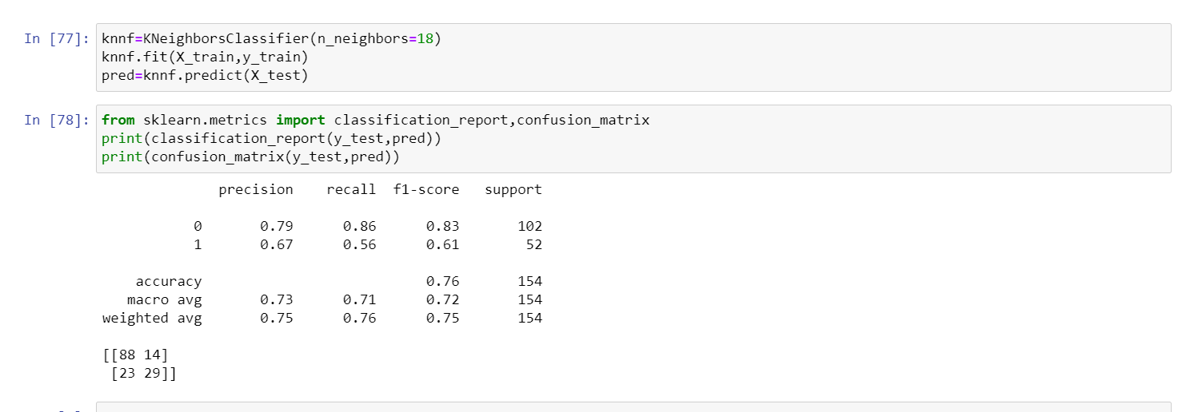

Slide 18
Thank You

